Slide 1


Xcode Career Service
关注 Xcode 即可获得热腾腾的高频题解析视频、面试技巧及准备tips、北美IT就业咨询等干货
一对一实习或工作信息咨询服务
一对一面试能力评定 + 修改简历
一对一Mock interview强化训练服务

Slide 2
想进 xcode 的刷题群，请加老师微信 singerdmx， 他会拉你进群

Slide 3
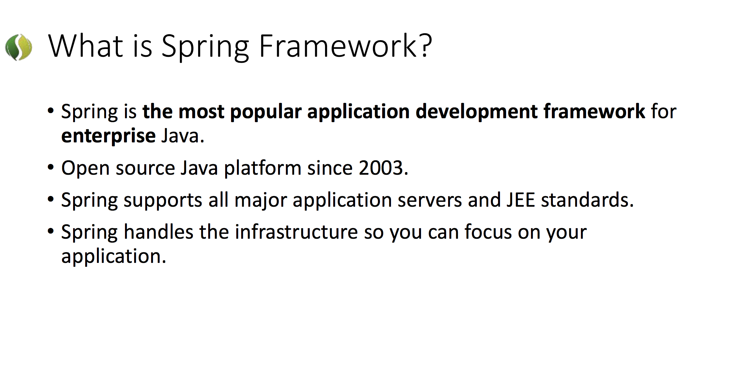

Slide 4
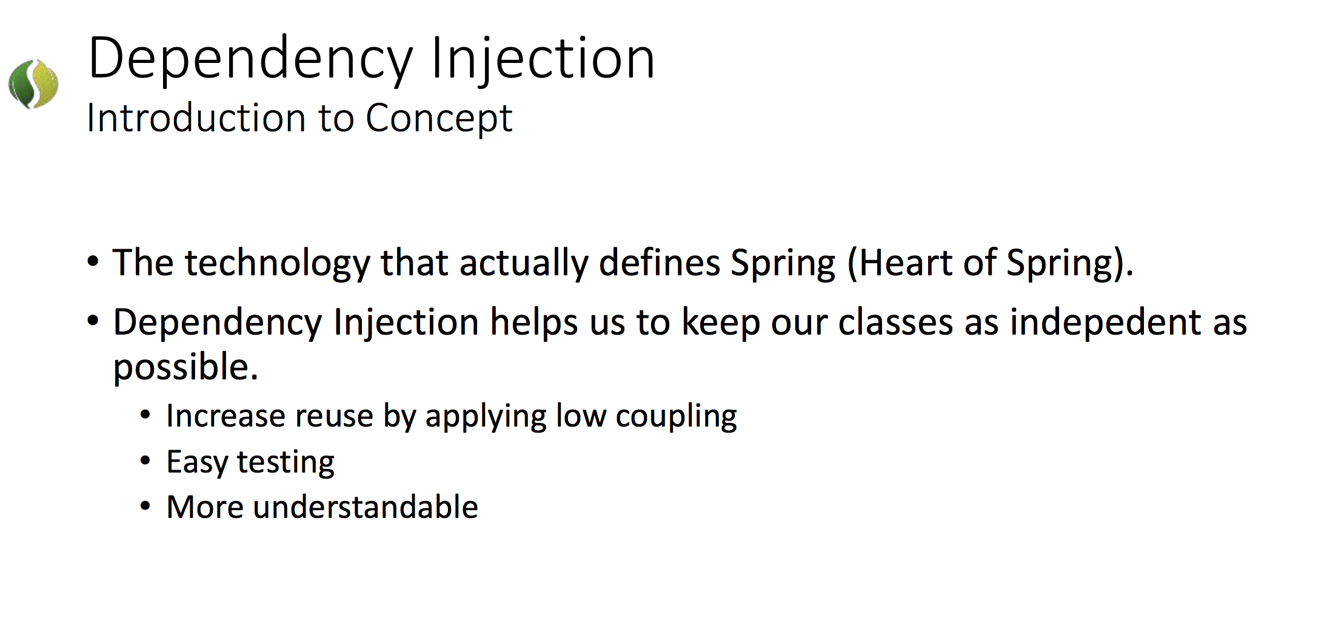

Slide 5
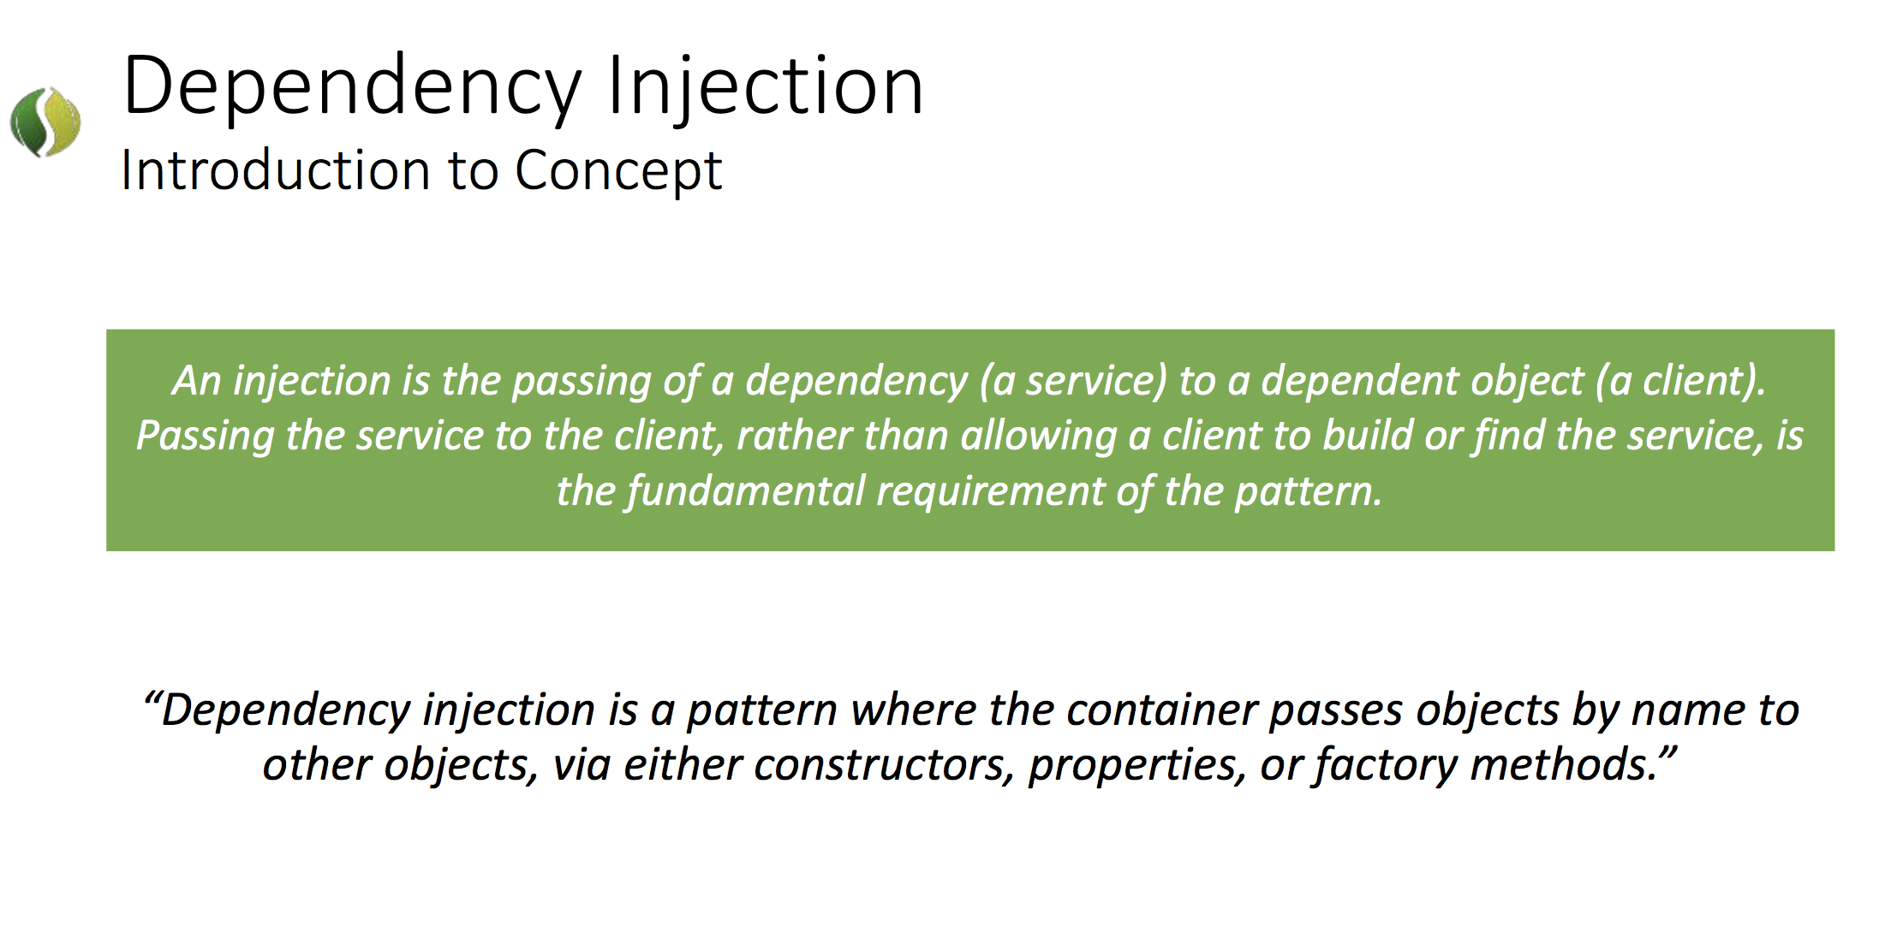

Slide 6
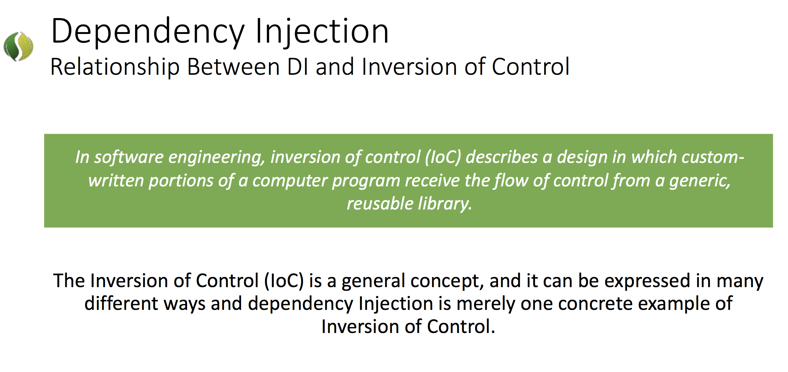

Slide 7
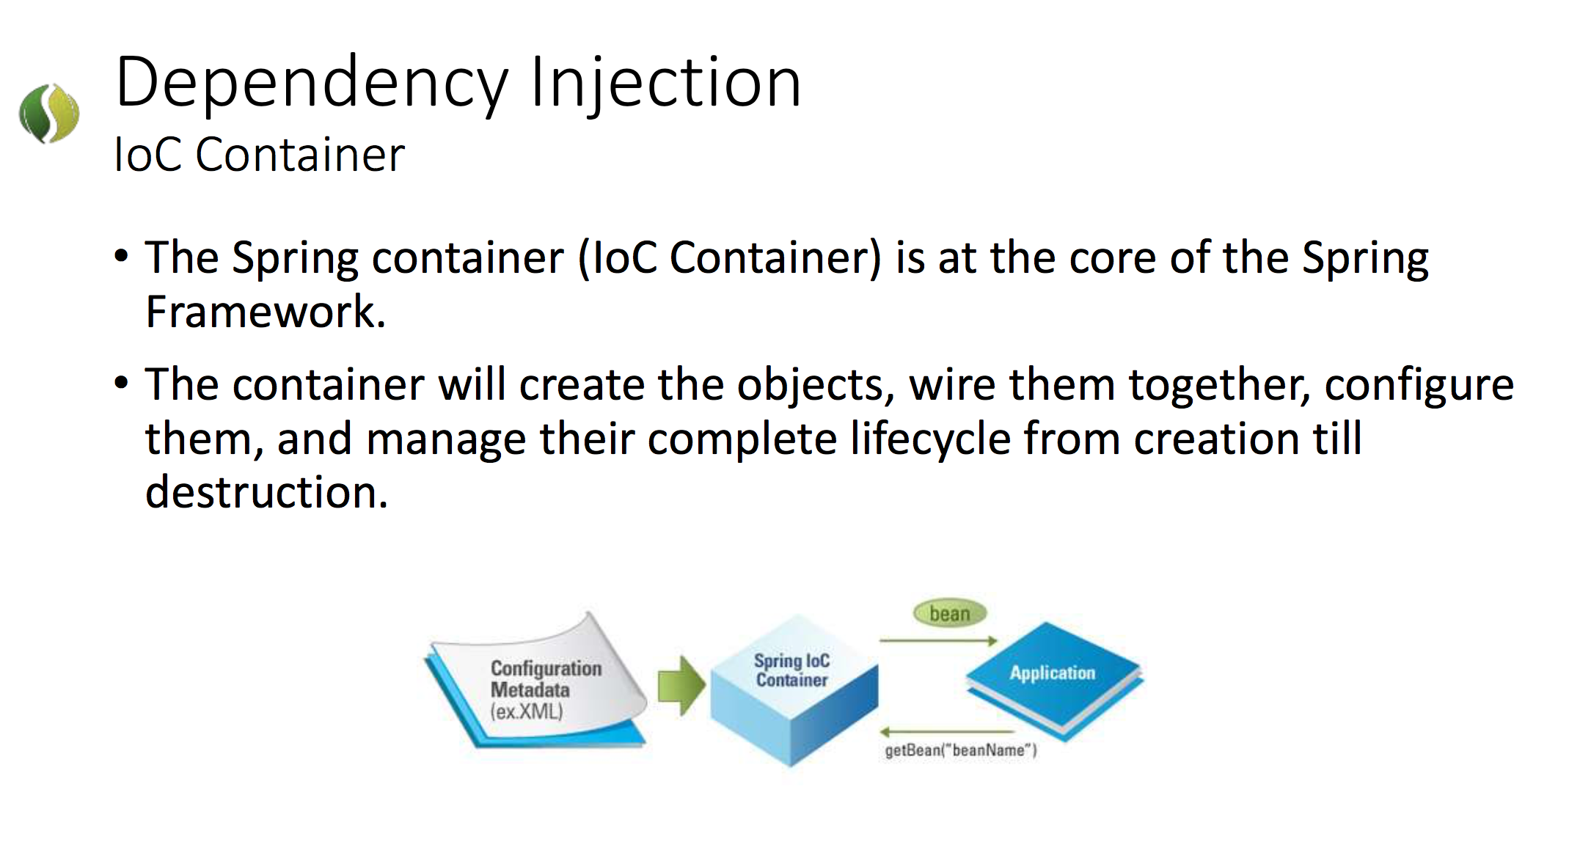

Slide 8
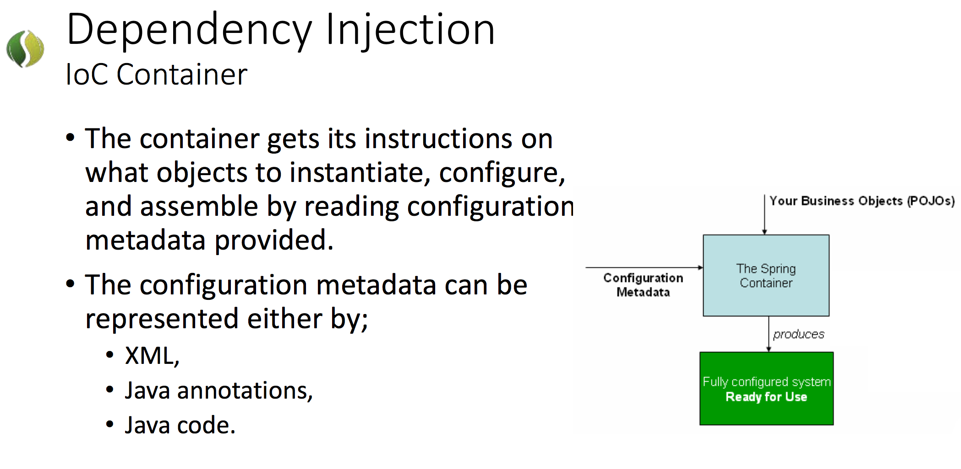

Slide 9
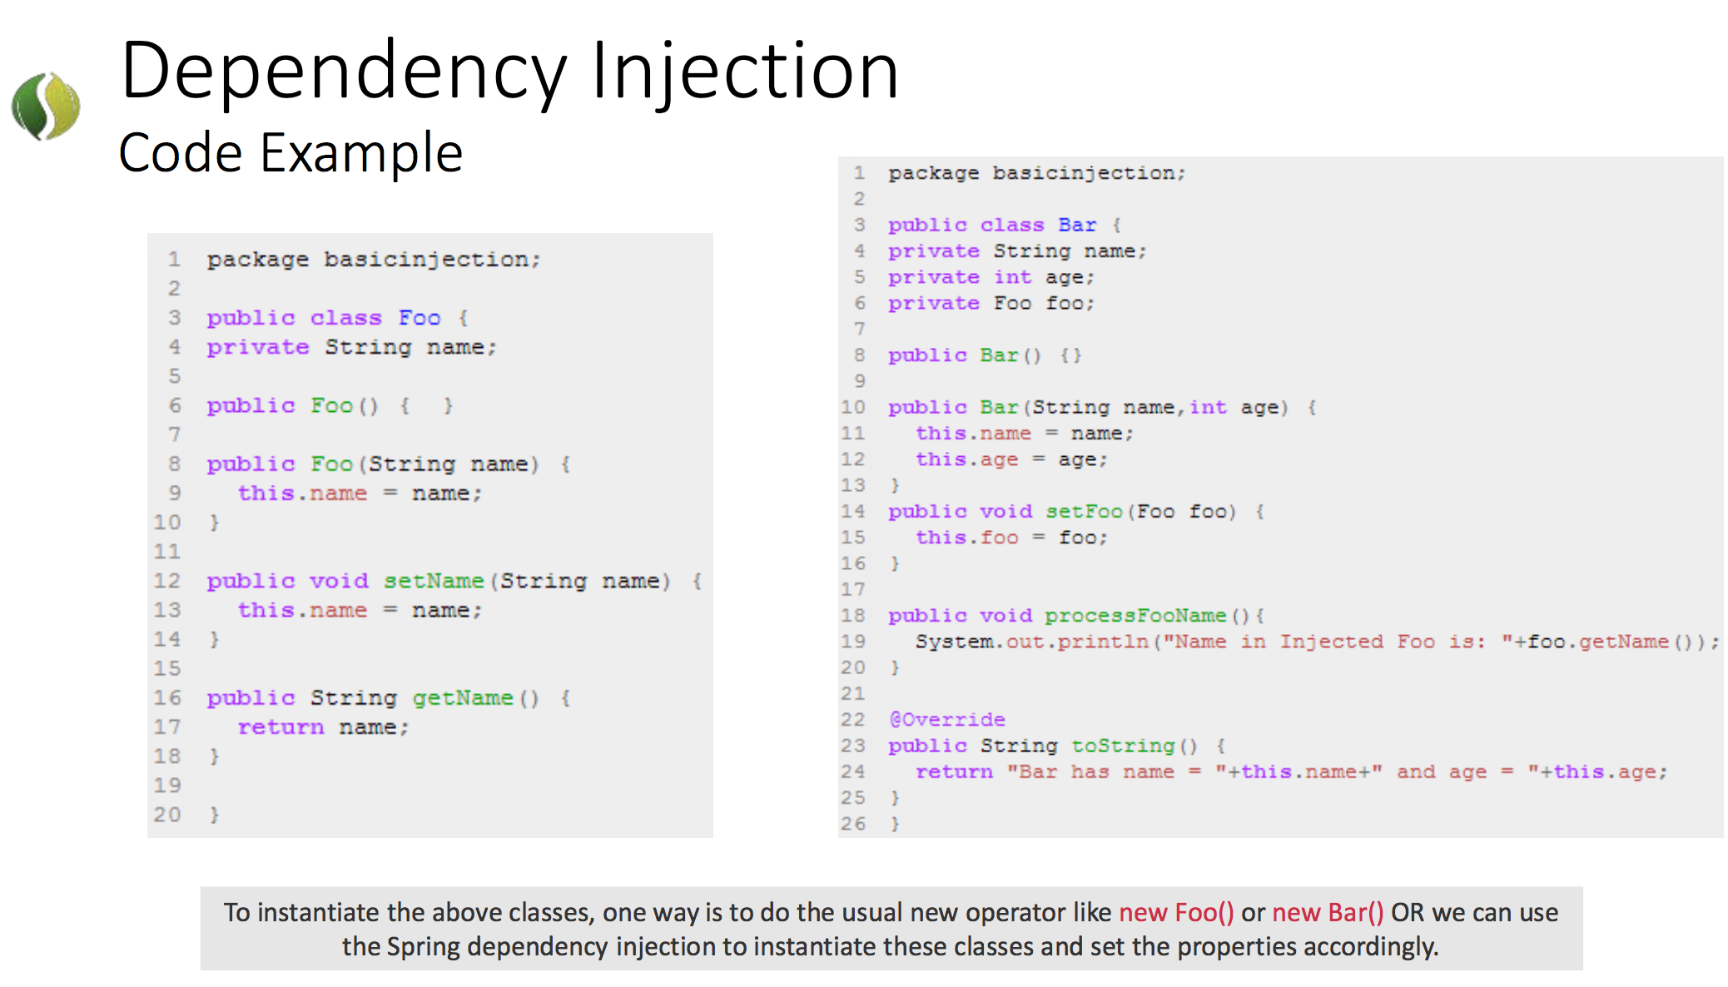

Slide 10
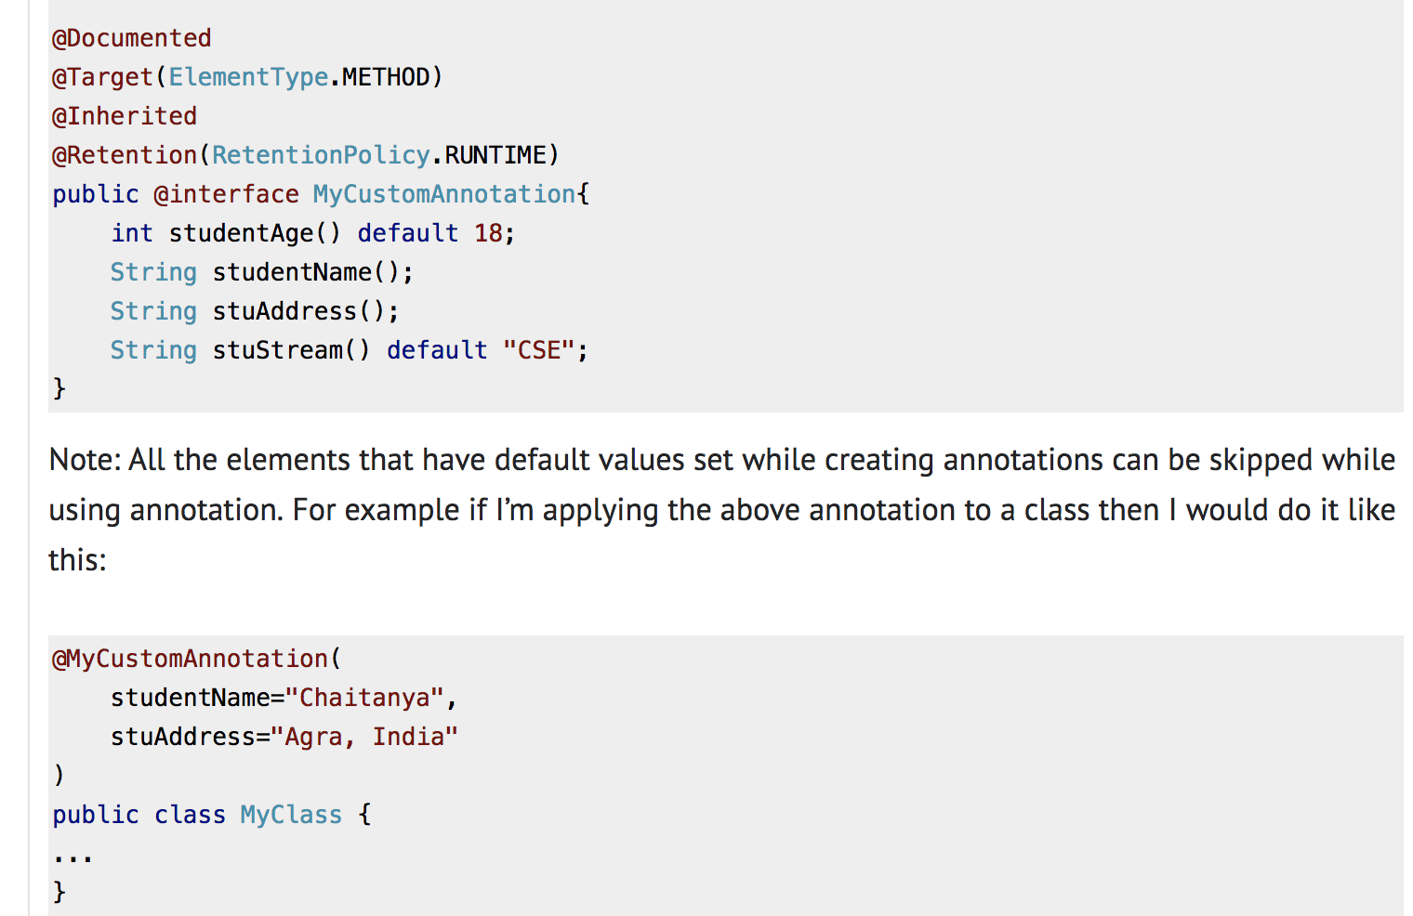
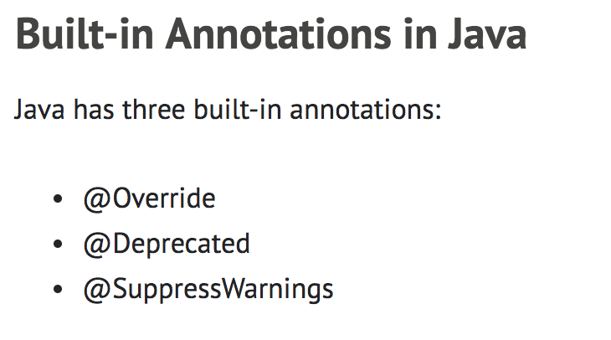

Slide 11
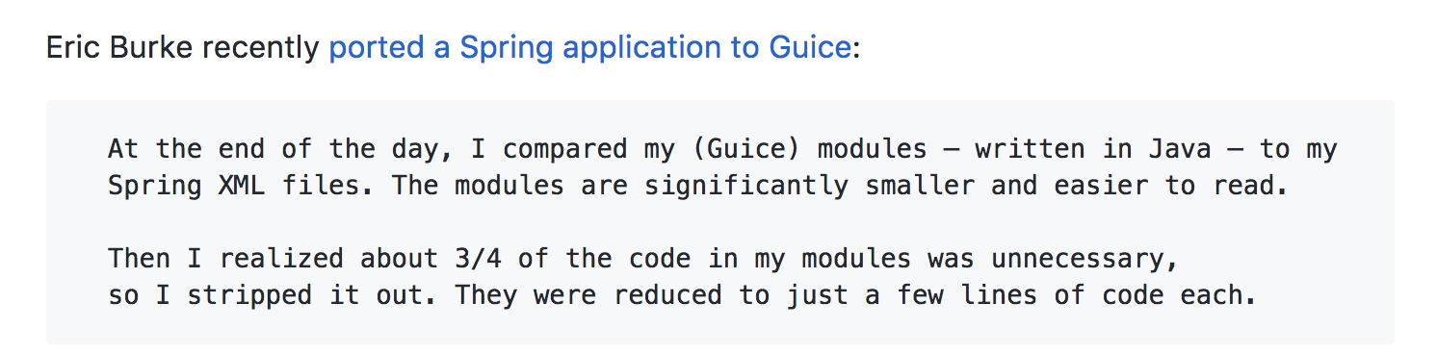
Guice

Slide 12
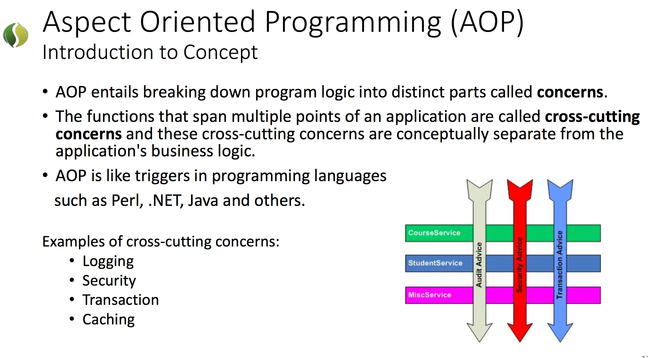

Slide 13
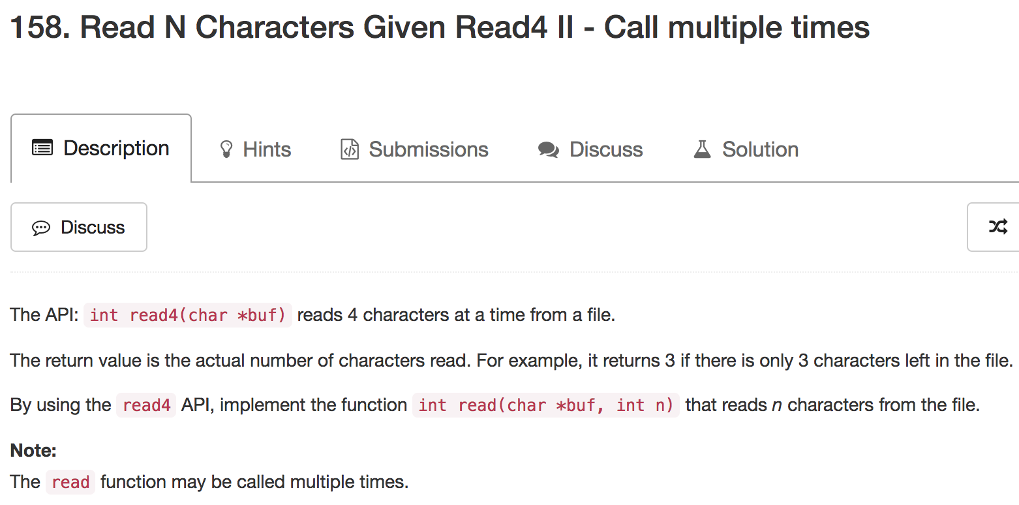

Slide 14
Multiple Times
=> Keep track of state

Slide 15
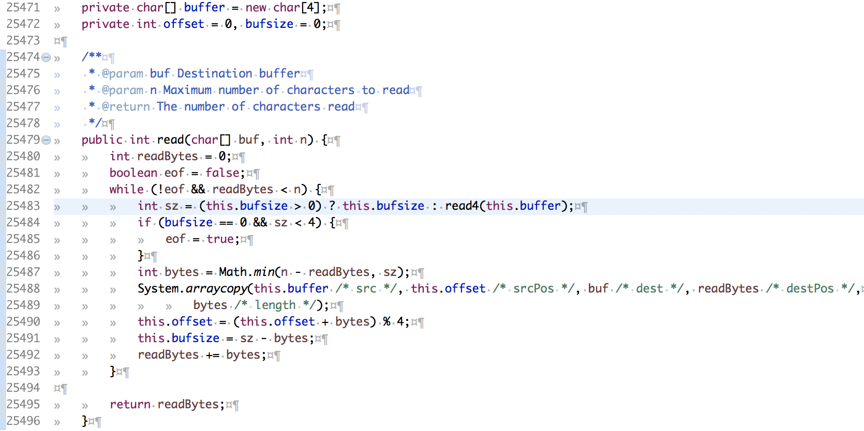

Slide 16
Buffer
A
B
A
A
C
C
D
B
A
A
A
A
bytes
copied to dest
bufsize
leftover bytes
sz: bytes read this time
May not need all of them,
limited by n
offset

Slide 17
Next Call
A
B
A
A
C
C
D
B
A
A
A
A
bufsize
leftover bytes
offset

Slide 18
Variation:
read4 returns
string or bytes
instead of integer
FB

Slide 19
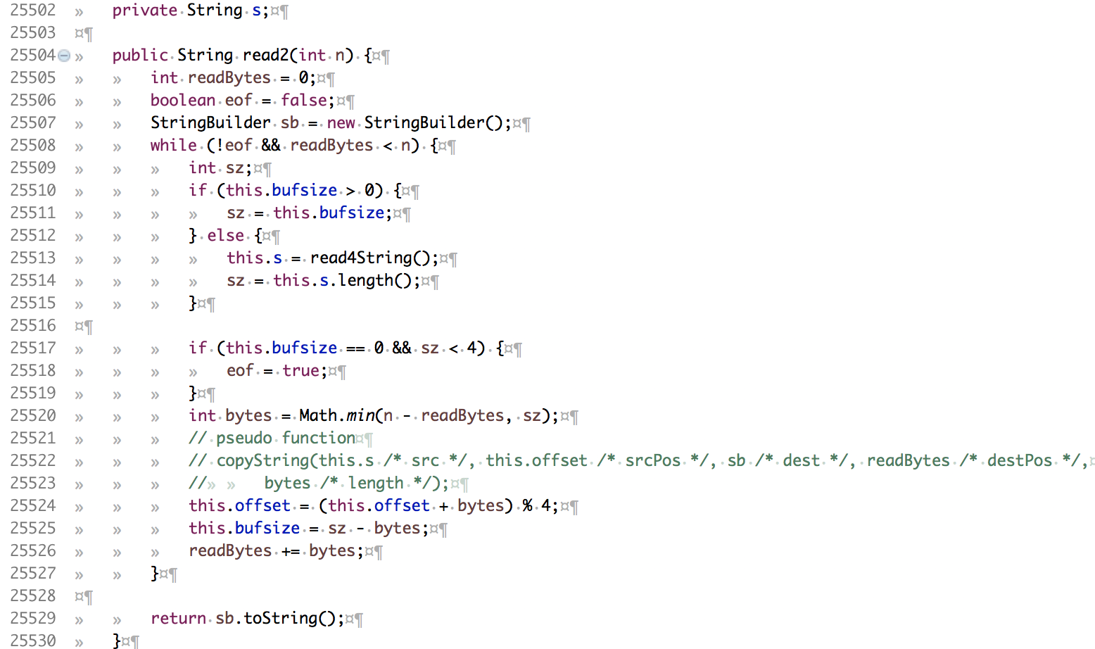
String read4String();

Slide 20
Union Find

Slide 21
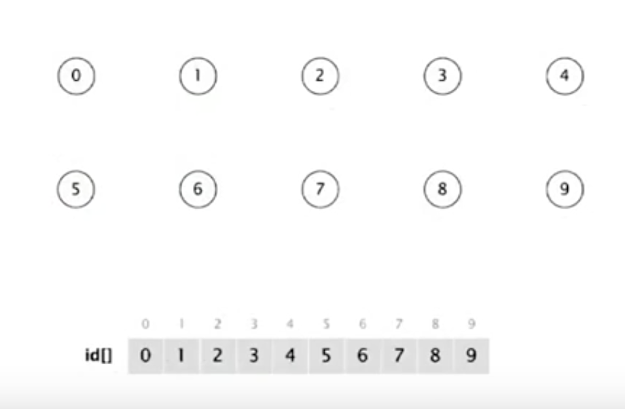

Slide 22
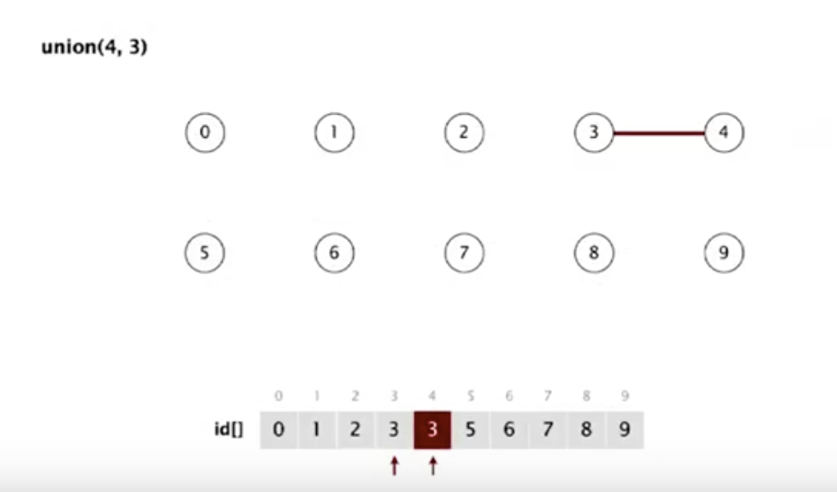

Slide 23
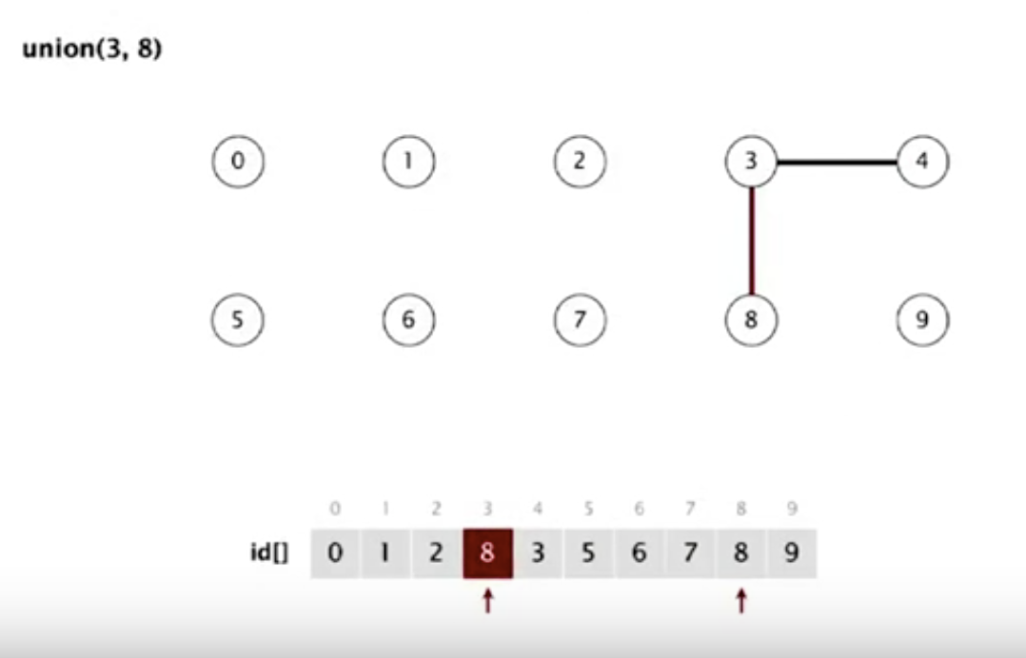

Slide 24
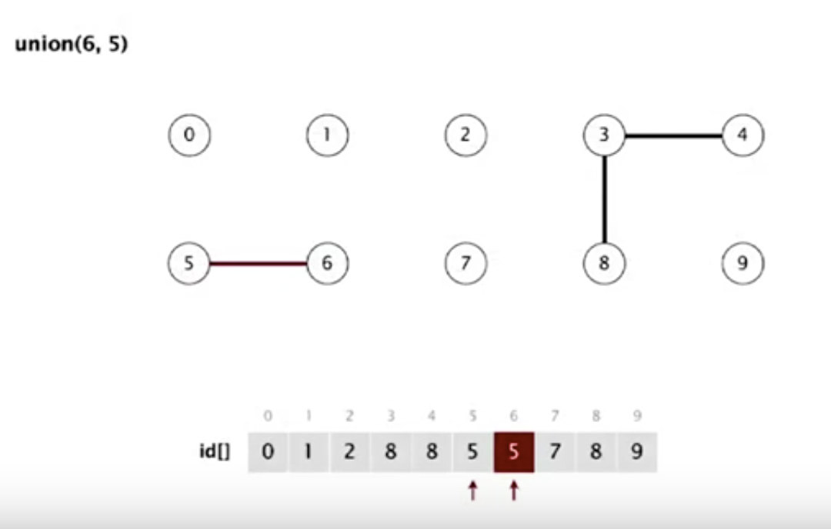

Slide 25
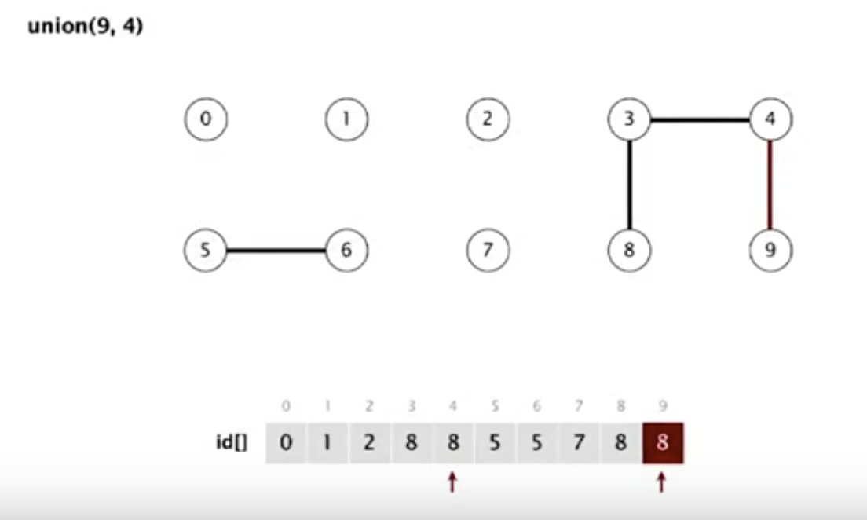

Slide 26
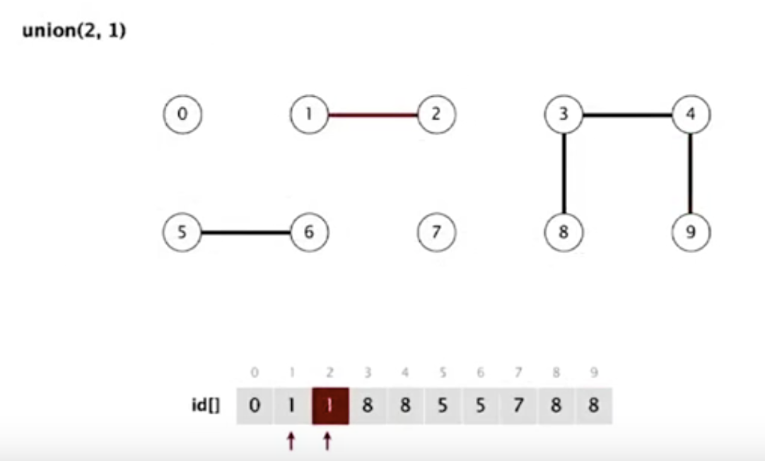

Slide 27
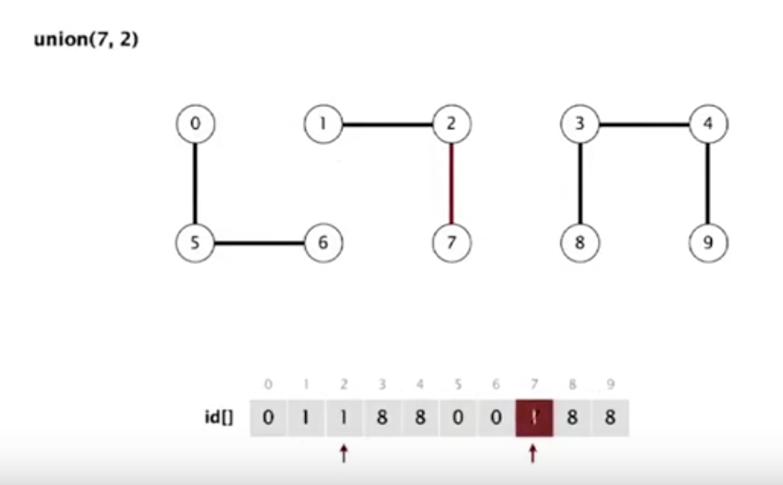

Slide 28
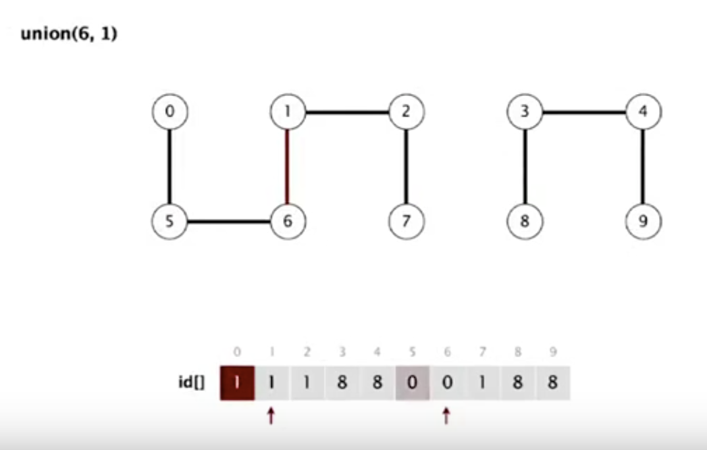

Slide 29
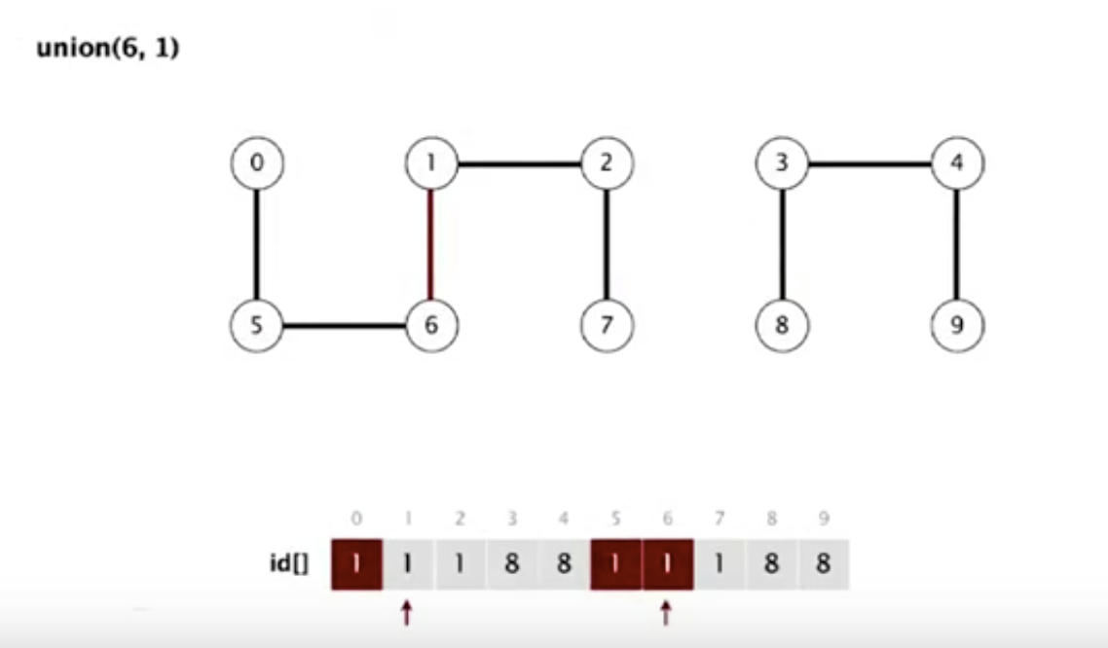

Slide 30
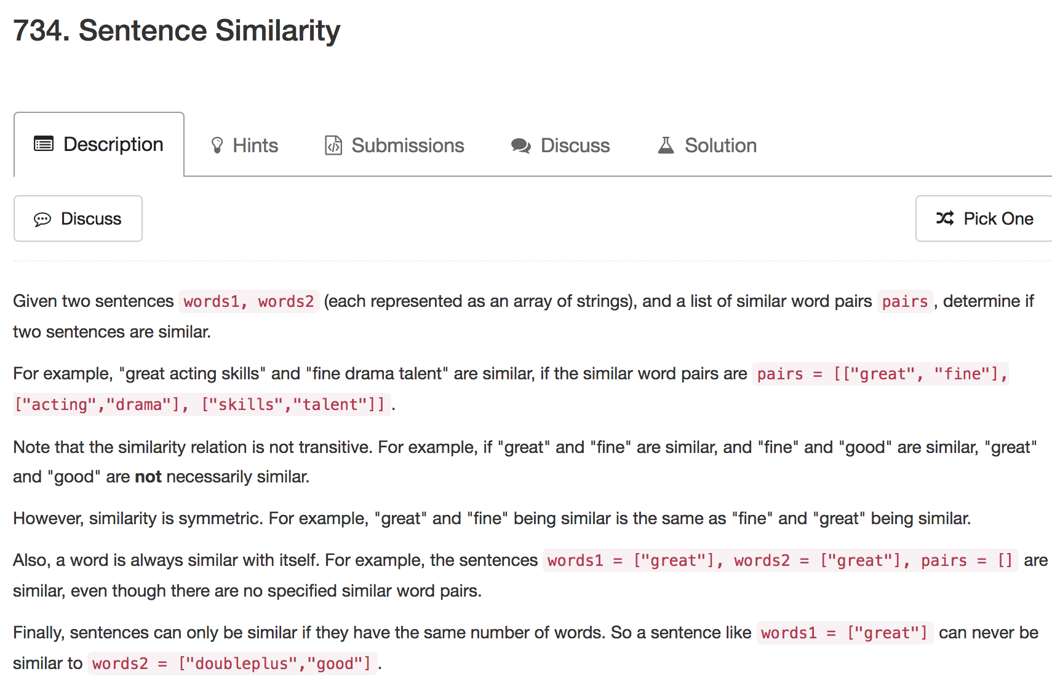

Slide 31
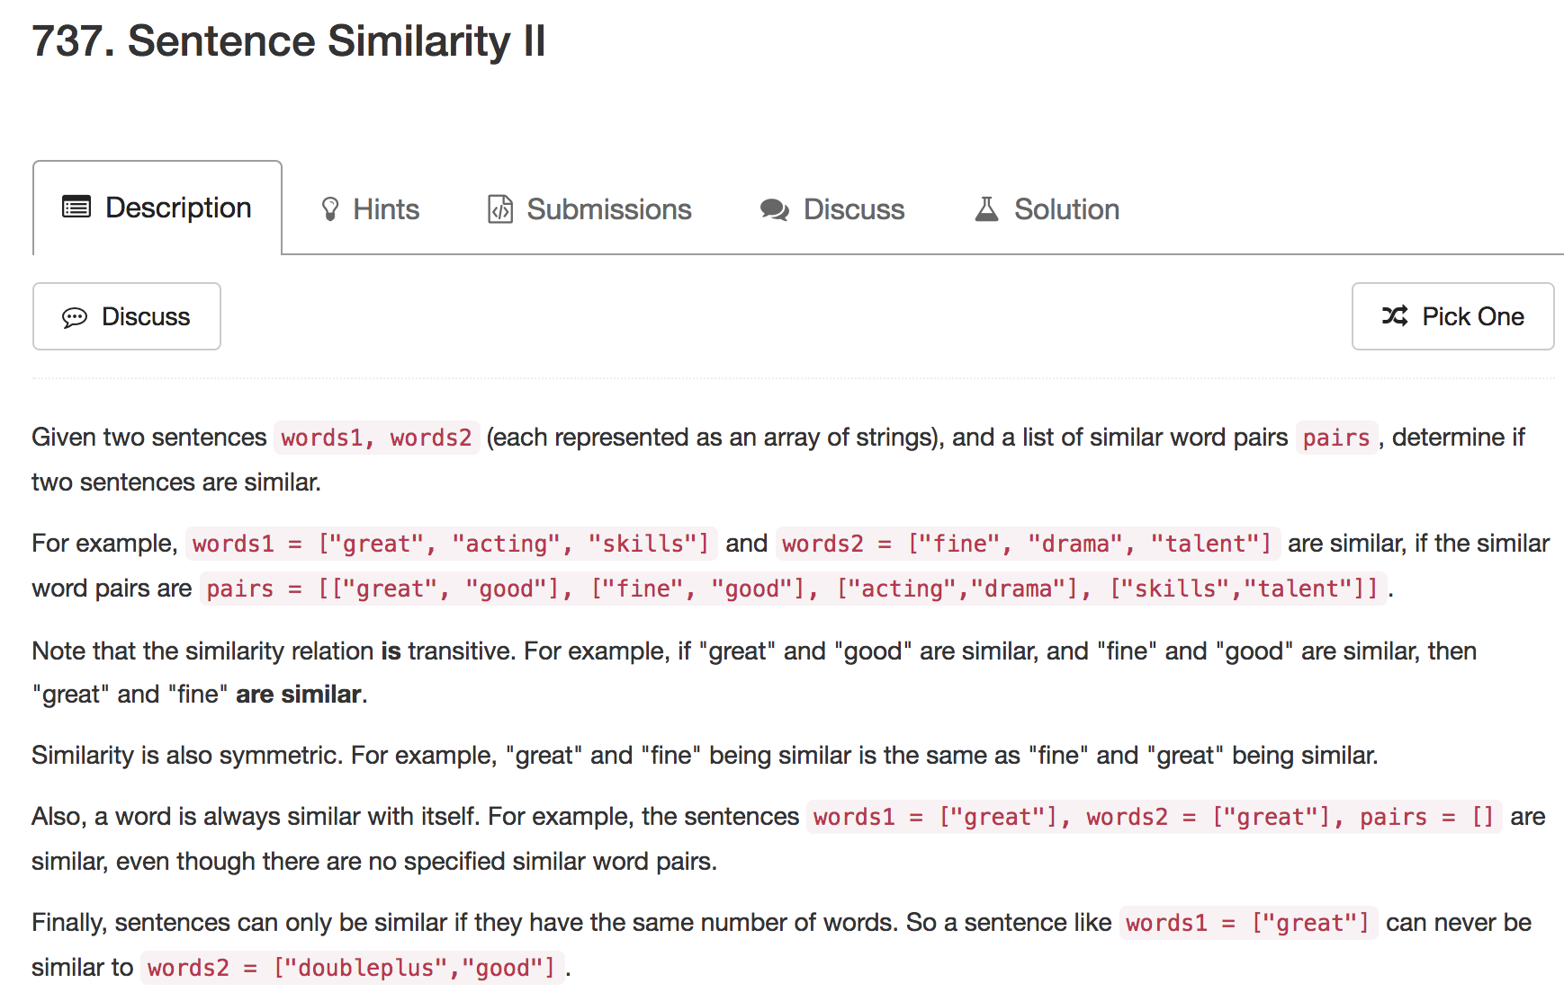

Slide 32
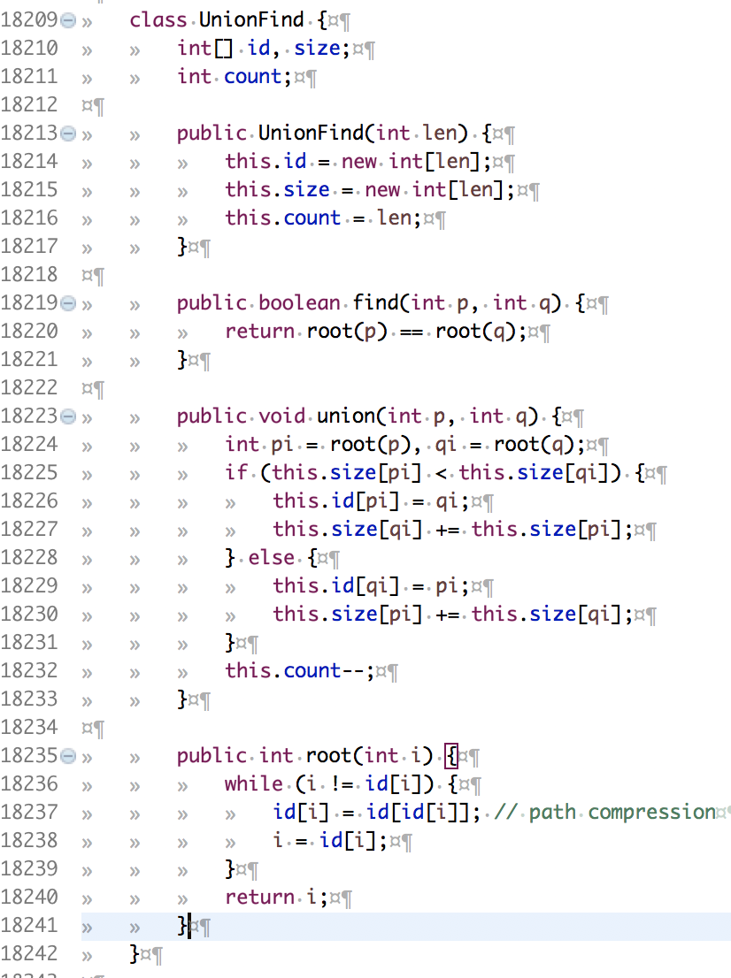

Slide 33
But …
Not always numbers

Slide 34
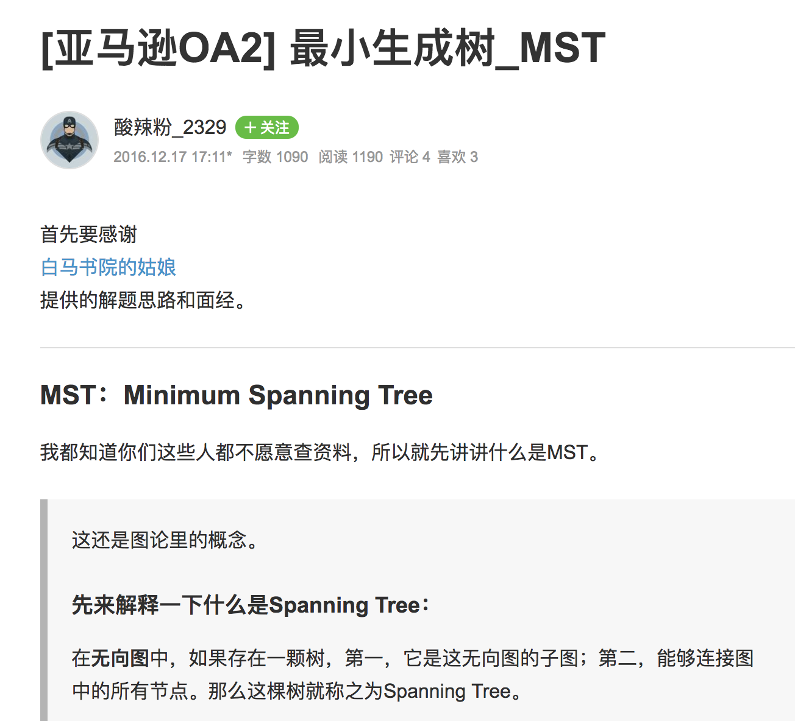
http://www.jianshu.com/p/04ca0fc1afab

Slide 35

http://www.jkeabc.com/244620.html

Slide 36
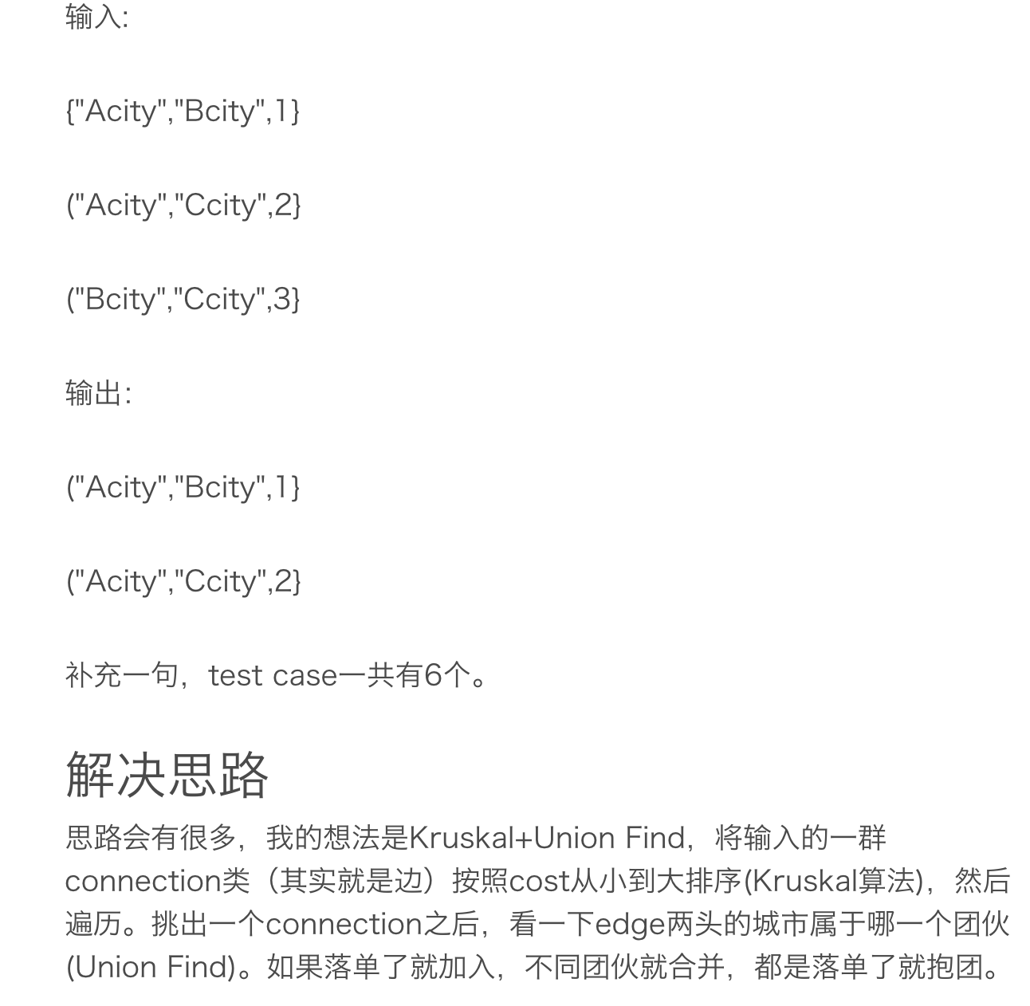

Slide 37
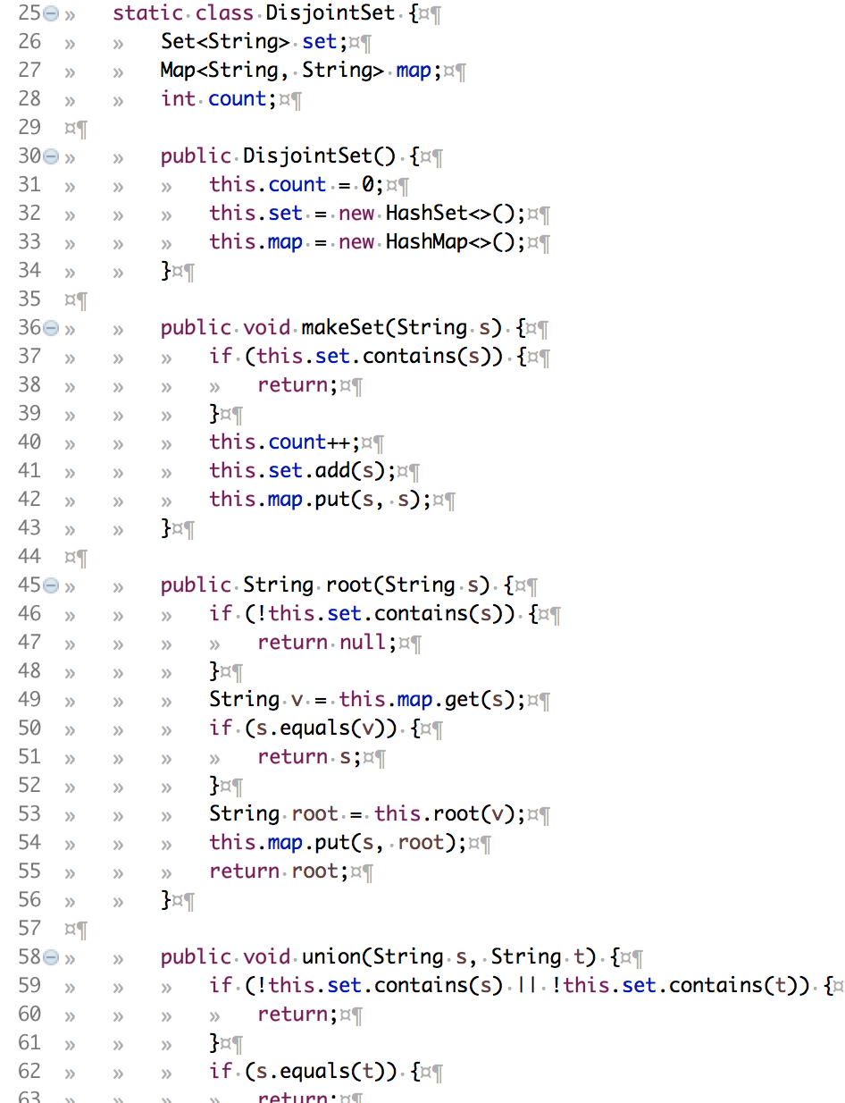

Slide 38
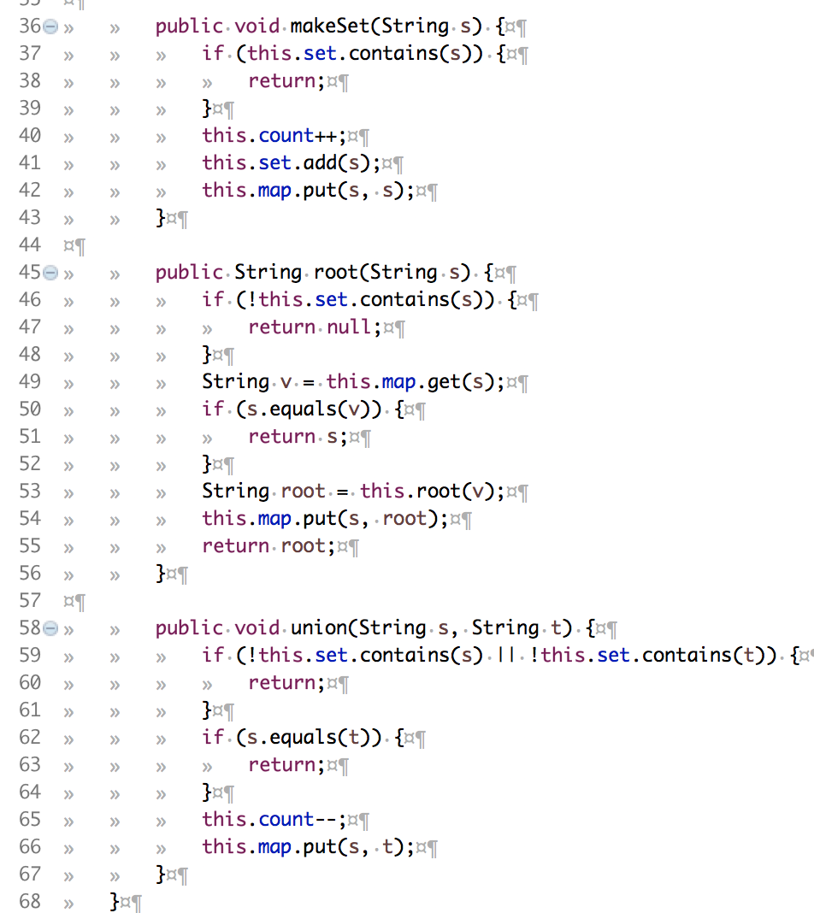

Slide 39
pairs = [["great", "good"], ["fine", "good"], ["acting","drama"], ["skills","talent"]]
Union 1:
great => good
fine => good
good => good
Union 2:
acting => drama
drama => drama
Union 3:
skills => talent
talent => talent

Slide 40
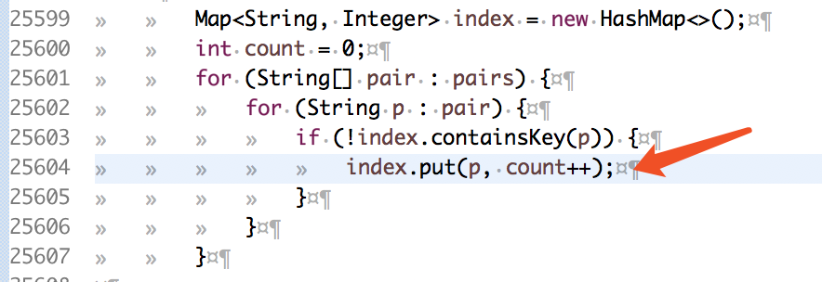
Two Ways
(A) Map<String, Integer> index
(B) Map<String, String> map
Union 1:
great => good
fine => good
good => good
Union 2:
acting => drama
drama => drama
Union 3:
skills => talent
talent => talent

Slide 41
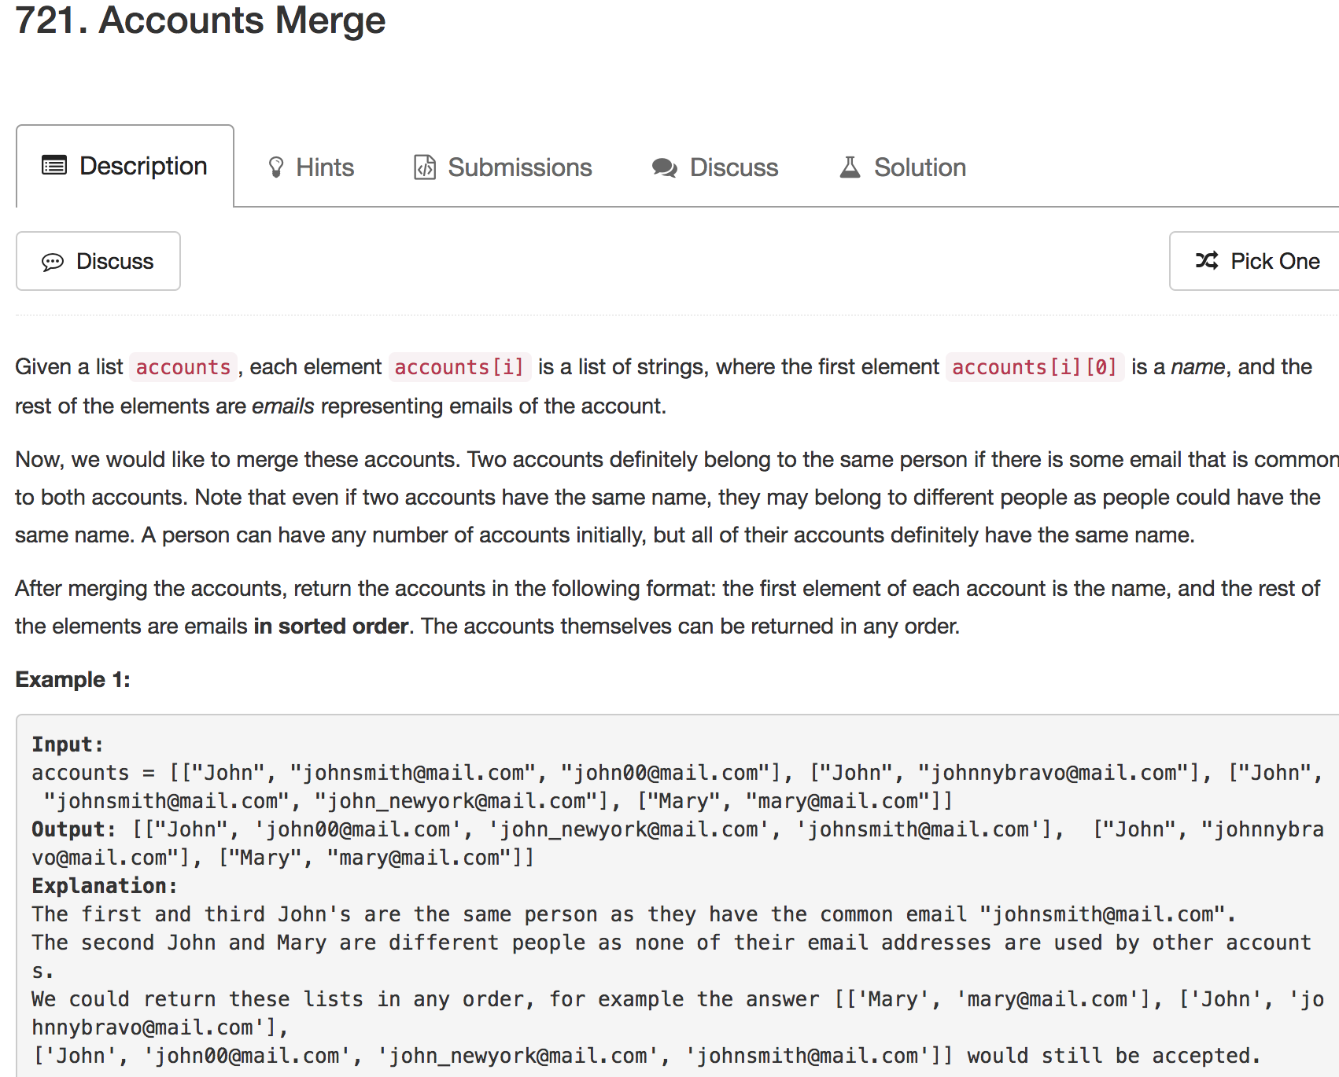

Slide 42
[["John", "johnsmith@mail.com", "john00@mail.com"], ["John", "johnnybravo@mail.com"], ["John", "johnsmith@mail.com", "john_newyork@mail.com"], ["Mary", "mary@mail.com"]]
Map<String, String> emailToName = new HashMap<>();
Map<String, Integer> emailToID = new HashMap<>();
emailToName：
< johnsmith@mail.com, John >
< john00@mail.com, John >
< johnnybravo@mail.com, John >
< john_newyork@mail.com, John >
< mary@mail.com, Mary >

Slide 43
[["John", "johnsmith@mail.com", "john00@mail.com"], ["John", "johnnybravo@mail.com"], ["John", "johnsmith@mail.com", "john_newyork@mail.com"], ["Mary", "mary@mail.com"]]
Map<String, String> emailToName = new HashMap<>();
Map<String, Integer> emailToID = new HashMap<>();
emailToID：
< johnsmith@mail.com, 0>
< john00@mail.com, 1>
< johnnybravo@mail.com, 2>
< john_newyork@mail.com, 3>
< mary@mail.com, 4>

Slide 44
[["John", "johnsmith@mail.com", "john00@mail.com"], ["John", "johnnybravo@mail.com"], ["John", "johnsmith@mail.com", "john_newyork@mail.com"], ["Mary", "mary@mail.com"]]
johnsmith@mail.com
john_newyork@mail.com
john00@mail.com
johnnybravo@mail.com

Slide 45
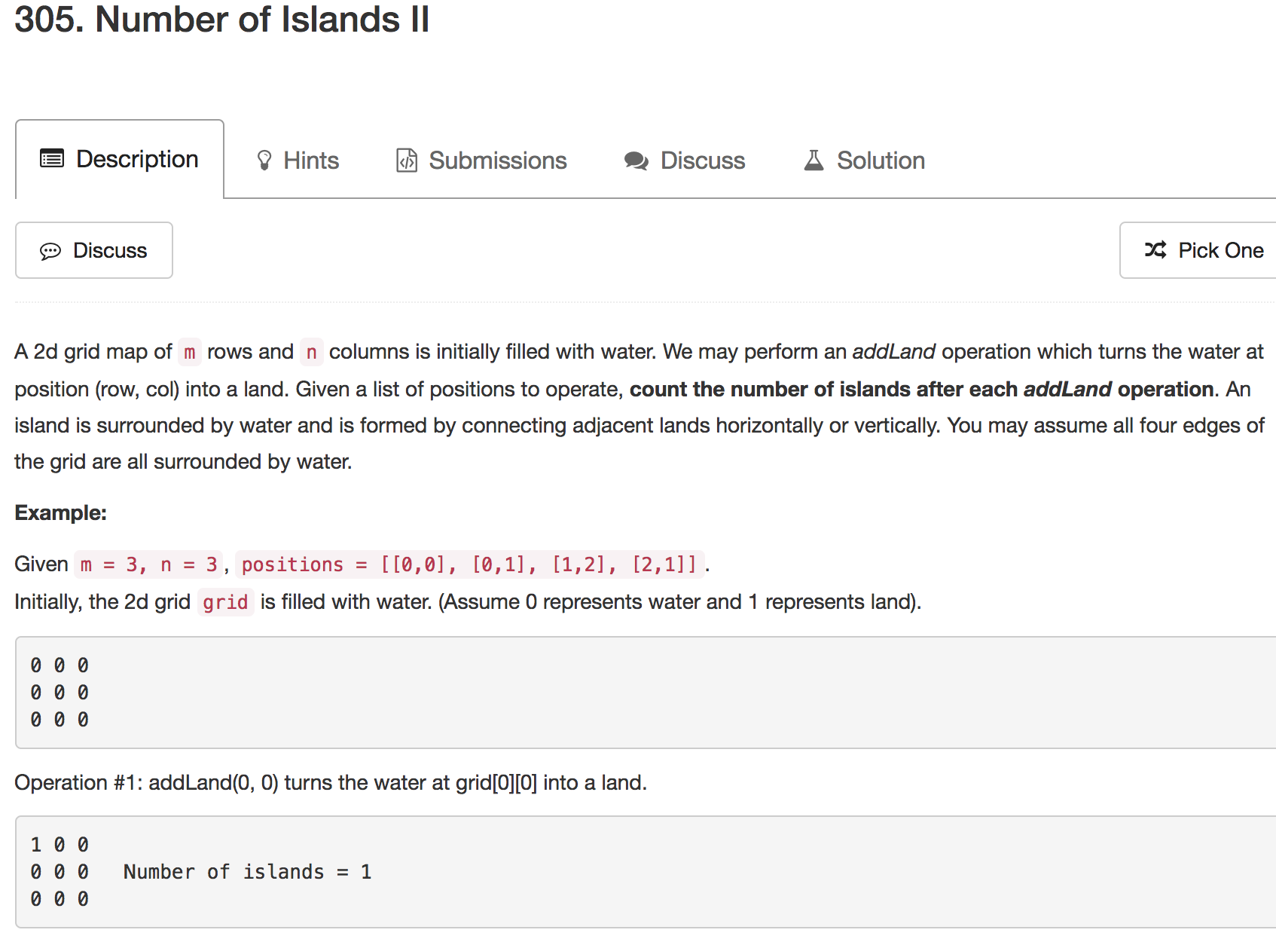

Slide 46
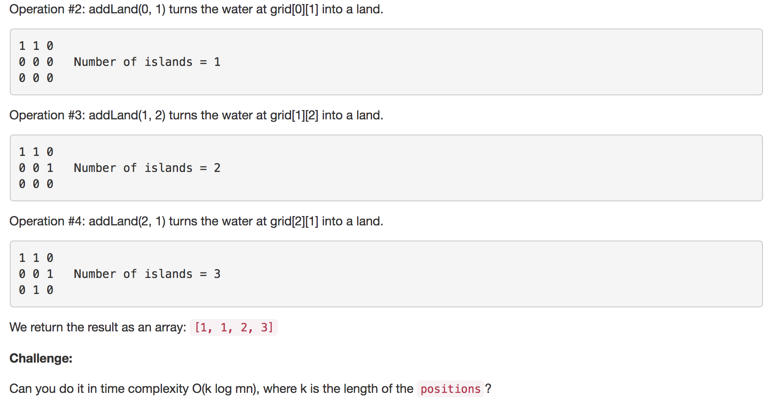

Slide 47
Two Dimensional Array
=> One Dimensional Array
int[][] arr = new int[m][n];
int[] a = new int[m * n];
arr[x][y] ⬄ a[x * n + y]

Slide 48
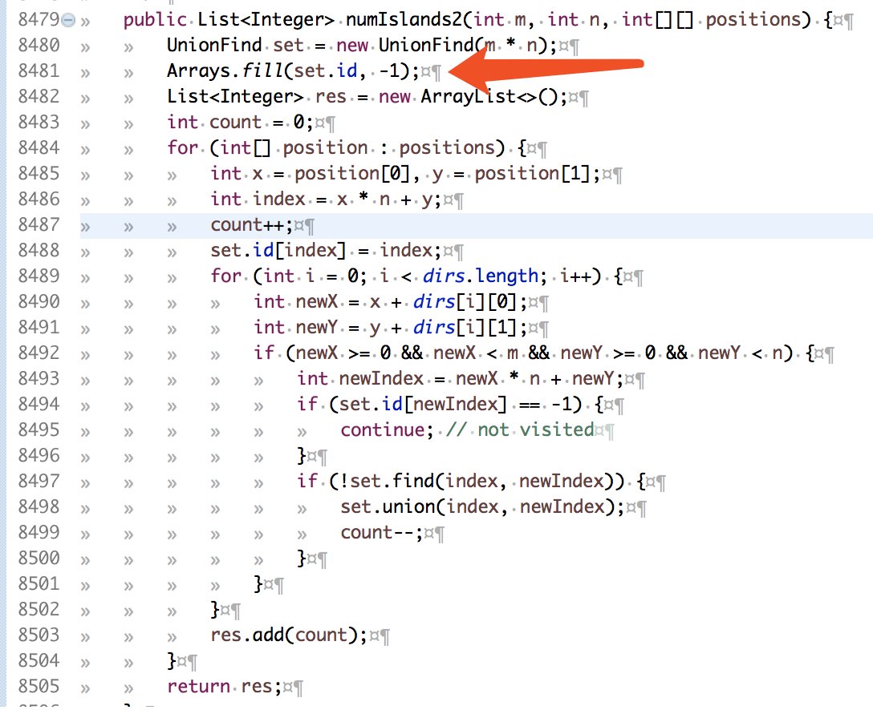

Slide 49
1
0
1
1
0

